Slide 1

A SEMINAR ON VIRTUAL FENCING BACHELORE OF TECHNOLOGY IN ELECTRONICS AND COMMUNICATION ENGINEERING Under the extreme guidance of Mr. R. DURGA GOPAL B.Tech., M. Tech., (Ph.D) Presented by E.DHANANJAI (23J25A0405) K.AKSHAY GUPTA (22J21A0415) H.NIKITHA (22J21A0411) RAGHAVENDRA (23J25A0412) JOGINPALLY B.R ENGINEERING COLLEGE DEPARTMENT OF ELECTRONICS AND COMMUNICATION ENGINEERING 2025-26

Slide 2
CONTENT:
INTRODUCTION
BLOCK DIAGRAM
COMPONENTS
SCHEMATIC CIRCUIT DIAGRAM
WORKING PRINCIPLE
RESULT
ADVANTAGES
LIMITATIONS
APPLICATIONS
CONCLUSION
FUTURE SCOPE
REFERENCE

Slide 3
INTRODUCTION:
AIM:- The aim of this project is to design and implement a Virtual Fencing System for grazing animals using GPS technology, which helps in monitoring and controlling the movement of animals without the need for a physical fence.
PREVIOUS SYSTEM:- Traditional fencing methods use physical barriers like wooden, barbed wire, or electric fences to restrict the movement of animals. These methods are costly, require regular maintenance, and often harm the environment and animals. Some electronic fencing systems exist, but they are limited in terms of flexibility, monitoring, and real-time control.
PROPOSED SYSTEM :- The project introduces a Virtual Fence system where each animal wears a GPS device that triggers a warning sound—and if needed, a mild shock—when it nears a set boundary. Farmers can adjust boundaries and monitor animals in real time via a mobile app, reducing costs and eliminating the need for physical fences.

Slide 4
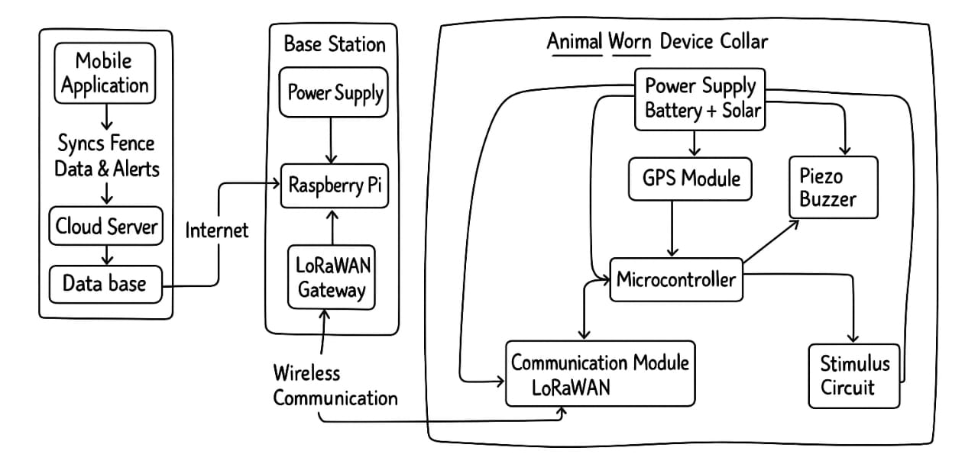
BLOCK DIAGRAM:-

Slide 5
COMPONENTS:
ESP32 Microcontroller
GPS Module
LoRaWAN Transceiver
Audio Actuator
Stimulus Circuit
Power System (Battery and Solar panel)
Antenna and Enclosure
Raspberry Pi 4 (8 GB RAM)
LoRaWAN Gateway Module

Slide 6
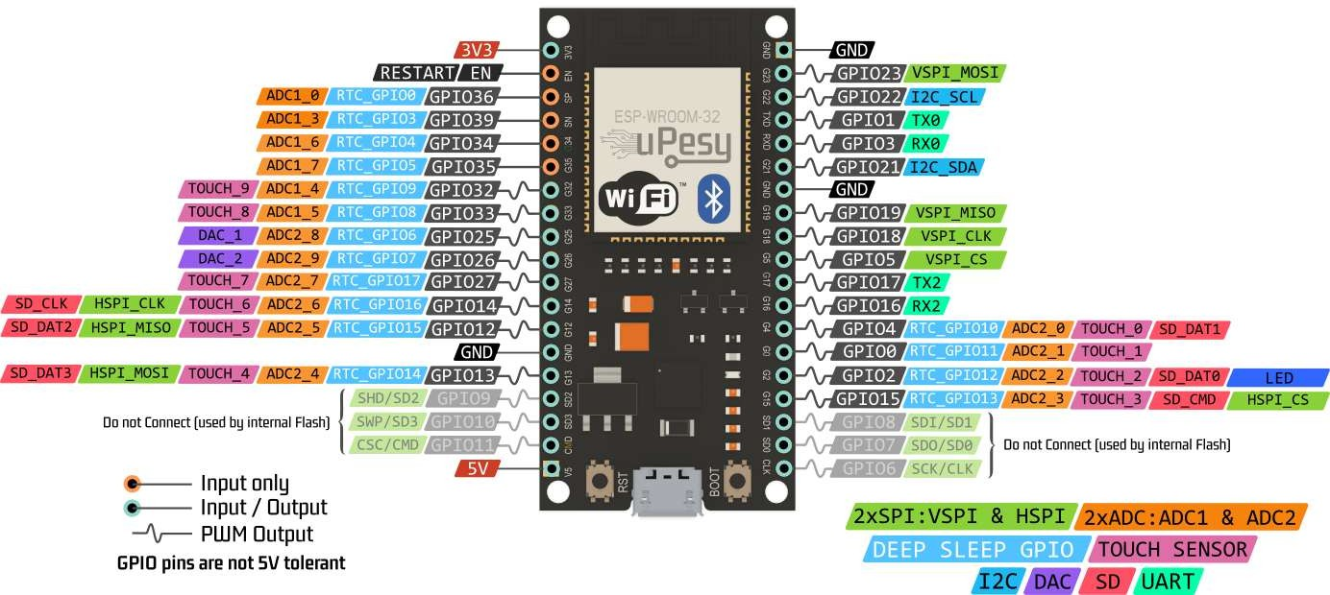
ESP32 MICROCONTROLLER:-
Purpose:-
Controls the entire operation of the collar: reading GPS, encoding data, sending packets, receiving commands from the base station, and controlling outputs such as buzzer and pulse circuit.
Features:-
ESP32 SoC (System-on-Chip) by Espressif Systems
Dual-core Tensilica Xtensa LX6 architecture
Up to 240MHz clock speed with 32-bit processing
No dedicated GPU, but includes hardware-
accelerated cryptography

Slide 7
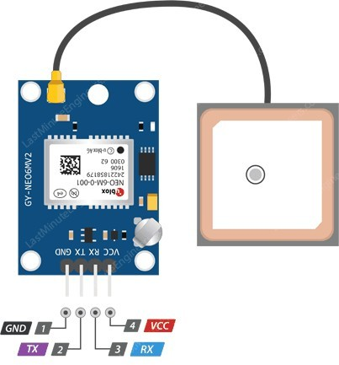
GPS MODULE:-
Purpose:-
It receives timing signals from multiple GPS satellites and computes the position by trilateration. The result is sent as NMEA strings to the microcontroller over UART. The firmware extracts latitude and longitude values from $GPGGA and $GPRMC sentences.
Features:-
High sensitivity and accuracy even in low-signal environments.
EEPROM memory to store configuration data.
Inbuilt Passive or Active antenna connector (via SMA or U.FL).
LED indicator blinks when a valid satellite fix is achieved.

Slide 8
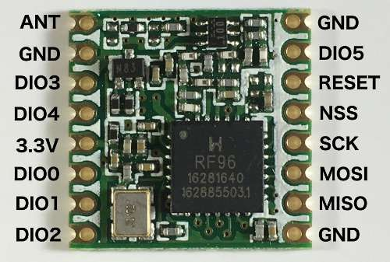
LORAWAN TRASCEIVER:-
Purpose:-
Provides reliable data transfer in open farmland areas without requiring cellular or Wi-Fi networks.
Features:-
Frequency Band: 868 MHz (ISM band)
Range: Up to 5–10 km line-of-sight
Sensitivity: –139 dBm
Interface: SPI / UART
Data Rate: 0.3 – 50 kbps

Slide 9
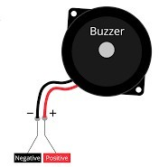
AUDIO ACTUATOR :-
Purpose:-
Acts as the first level of deterrence—after conditioning, animals usually respond to sound alone, reducing the need for electric stimulus.
Features:-
Weight : ~5 g
Polarity : Marked with "+" for positive terminal
Material: Plastic casing, piezo ceramic disc inside
Type: Active or Passive

Slide 10
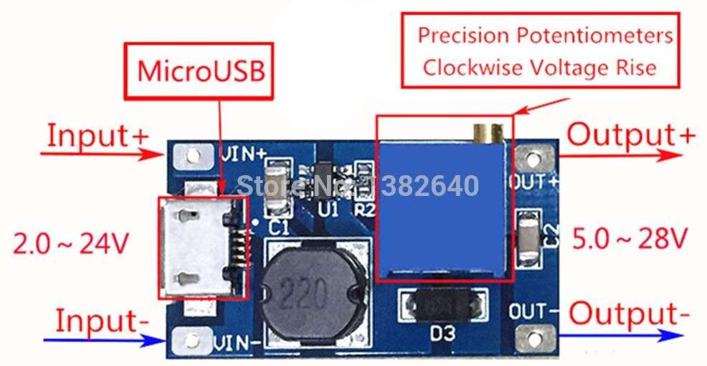
STIMULUS CIRCUIT :-
Purpose:-
Serves as the second-level corrective action. It is humane, safe, and designed to startle, not harm, the animal.
Features:-
IC Used: MT3608 Step-Up Converter
Input Voltage Range: 2V – 24V DC
Output Voltage Range: 5V – 28V DC (adjustable)
Output Current: Up to 2A (peak), 1A continuous
recommended

Slide 11
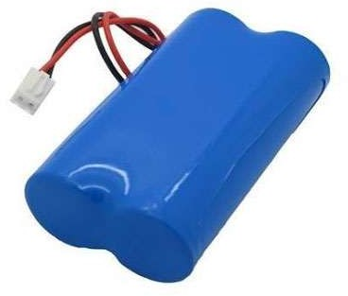
POWER SYSTEM (BATTERY AND SOLAR PANEL):-
Purpose:-
The power system keeps the collar running continuously without frequent maintenance.
Features:-
Li-ion battery 3.7 V / 4000 mAh
Solar panel 5 V / 1 W
TP4056 charging IC with protection circuit
AMS1117-3.3 V regulator for stable supply

Slide 12
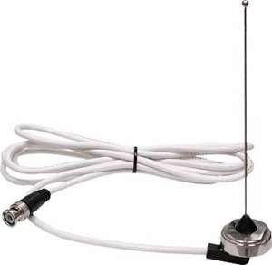
ANTENNA AND ENCLOSURE:-
Purpose:-
The antenna is used to enable long-range wireless communication between the animal collar and the base station. It helps transmit GPS location data and receive virtual boundary alerts, ensuring reliable real-time tracking and control in the virtual fencing system.
Features:-
Frequency range: Around 855 to 880 MHz, centered on 868 MHz
Wavelength: 1/4 wavelength (~8.6 cm for 868 MHz)
Gain: Approximately -3.65 dBd (around -1.5 dBi) for basic
models, or up to 2-4 dBi for optimized designs
VSWR (Voltage Standing Wave Ratio): Less than 1.9 typical
at center frequency, indicating good impedance matching.

Slide 13
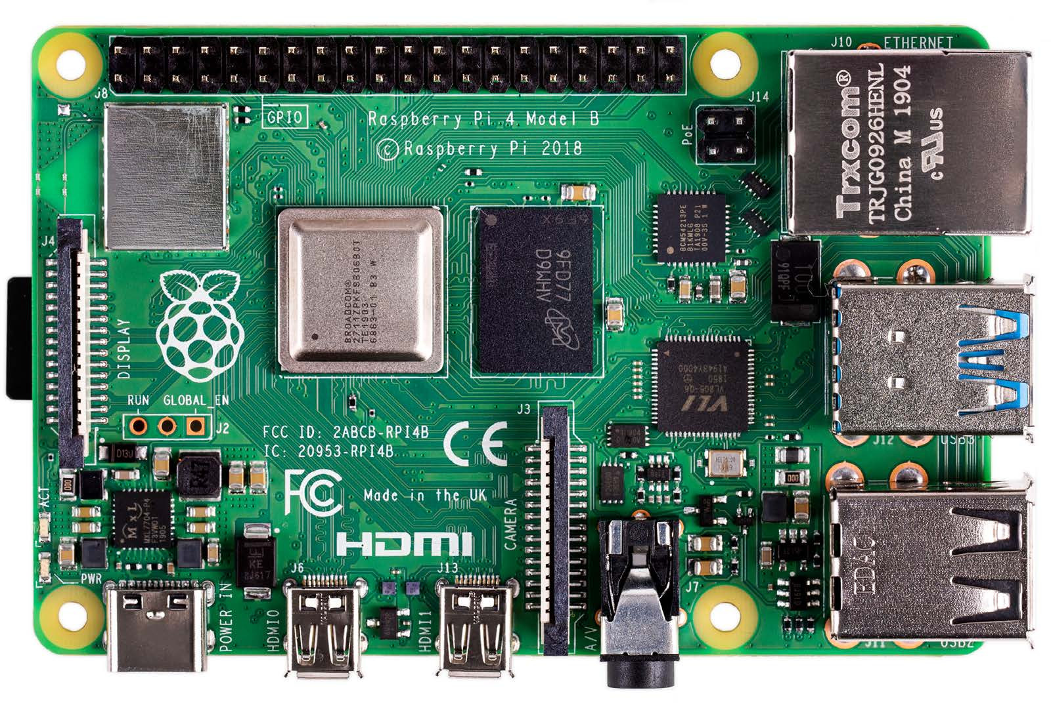
RASPBERRY PI 4 (8 GB RAM):-
Purpose:-
Acts as the main processing node and gateway, eliminating the need for cloud servers or internet connectivity.
Features:-
IC Used MxL7704 Power Management IC (PMIC)
Input Voltage Range 5V DC (USB-C or GPIO),
Absolute Max: 6V
Output Voltage Range 3.3V, 1.8V, 1.2V, 1.5V, 1.0V
(from PMIC for SoC, memory, I/O, etc.)
Output Current Up to 3A (recommended), 2.5A
minimum for light loads

Slide 14
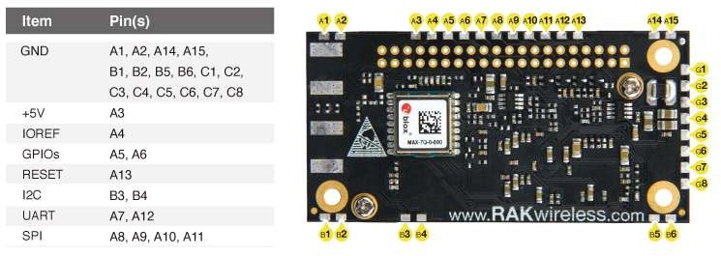
LORAWAN GATEWAY MODULE:-
Purpose:-
Provides robust and scalable wireless coverage, enabling the monitoring of many animals under a single gateway.
Features:-
3V3 Power +3.3 V power supply
5V Power +5 V power supply
SDA1 I/O I²C data
5V Power +5 V power supply

Slide 15
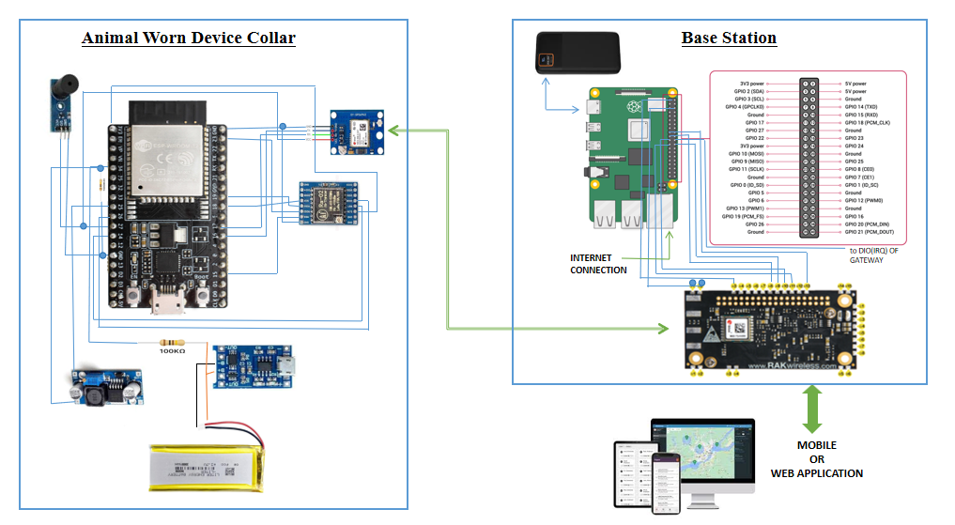
CIRCUIT DIAGRAM

Slide 16
SOFTWARE REQUIREMENTS
Collar Tag
Arduino IDE Software
C / C++ programming language
2. Base Station
Raspberry Pi OS
Python language
3. LoraWan Communication
LoraWan Packet Forwarder
4. Web Application
Framework (Django)
API’s (Googlemaps API)
Database (MySQL)

Slide 17
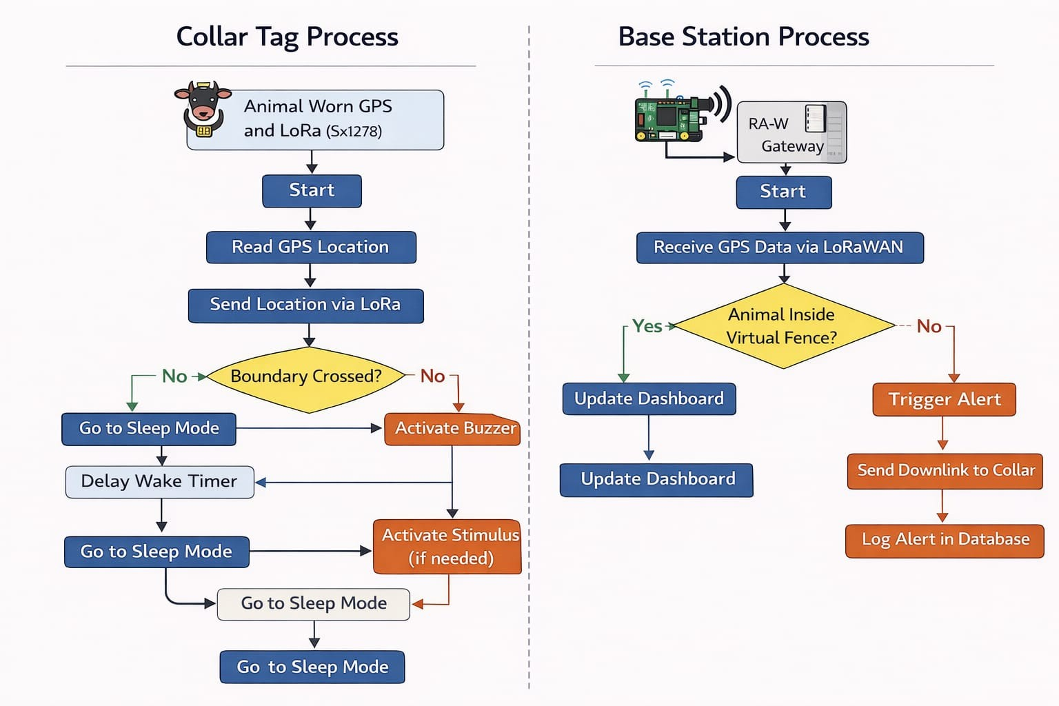
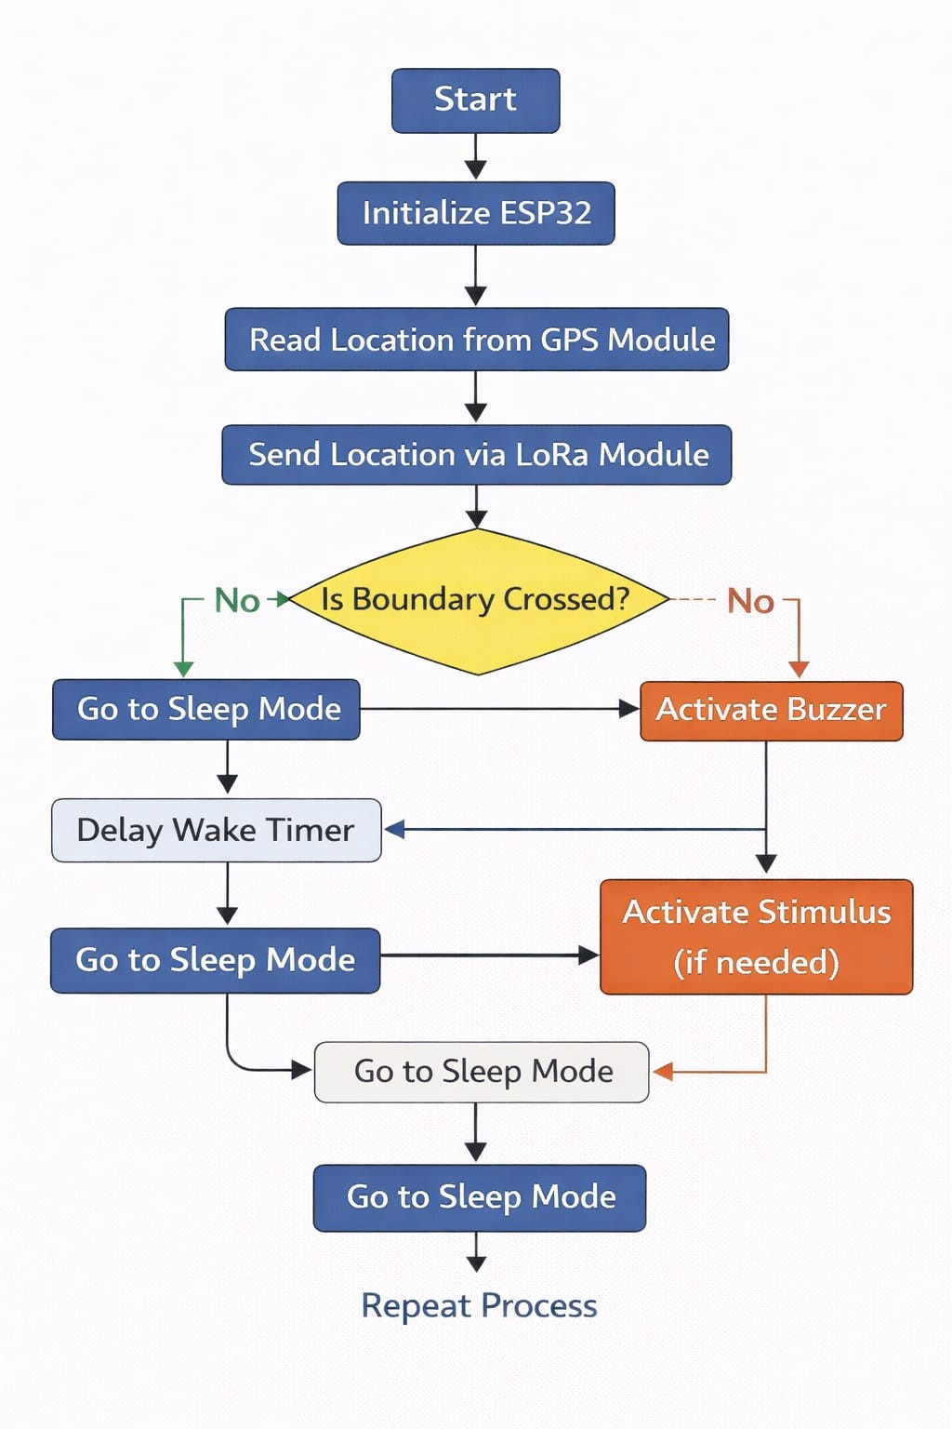
FLOW CHART
Repeat the Process

Slide 18
RESULT:
The Virtual Fencing System tracked animals in real time using GPS collars that sent data to a Raspberry Pi via LoRaWAN. A virtual boundary was monitored, and any animal crossing it triggered instant alerts. The collar then activated a buzzer and, if needed, a mild pulse to guide the animal back. Overall, the system performed accurately, with long range, fast response, and a simple user interface for farmers.

Slide 19
ADVANTAGES:
The system eliminates the need for physical fences, reducing cost and land obstruction.
Operates autonomously using GPS and LoRaWAN without constant human supervision.
Uses LoRaWAN communication, which provides long range (up to 5–10 km) and works even in areas without internet or cellular networks.
Each collar tag is solar-powered, reducing the need for frequent recharging and ensuring long-
term field operation.
The system provides real-time location tracking and displays all animal positions on a map interface.

Slide 20
LIMITATIONS:
The initial setup cost may be higher compared to simple wired fences, due to electronic components.
The GPS module may experience reduced accuracy in dense forests, hilly terrain, or during poor satellite reception.
LoRaWAN range can vary based on terrain and physical obstructions such as trees or buildings.
The mild electric stimulus requires careful calibration to avoid discomfort to animals.
The solar charging efficiency may drop during cloudy or rainy weather, reducing battery runtime.

Slide 21
APPLICATIONS:-
Livestock Management:
Used to control and monitor the grazing area of animals such as cattle, goats, and sheep without physical fences.
Smart Farming:
Enables farmers to create adjustable virtual boundaries and manage herds more efficiently through IoT automation.
Animal Tracking and Research:
Useful in wildlife conservation or behavioral research for monitoring animal movements and migration patterns.

Slide 22
CONCLUSION:
The Virtual Fencing project successfully demonstrates an effective, low-cost system for monitoring and controlling animal movement without physical barriers. Using GPS, wireless communication, and smart alerts, it provides real-time tracking and ensures animal safety while reducing manual effort. This project serves as a practical solution for modern farming and can be further expanded for large-scale livestock management.

Slide 23
FUTURE SCOPE
1. AI-Based Animal Monitoring
Integrate Artificial Intelligence to analyze animal movement patterns and detect abnormal behavior, health issues, or unusual activity automatically.
2. Cloud & Mobile App Integration
Connect the system to a cloud platform and develop a dedicated mobile app for remote monitoring, real-time alerts, and large-scale farm management from anywhere.

Slide 24
REFERENCE:
Anderson, D. M., Hale, C. S., and Nolen, B., Virtual Fencing: Adaptive and Ethical Livestock Management, Journal of Animal Science, Vol. 81, pp. 285–293, 2003.
Umstatter, C., The Evolution of Virtual Fencing: A Review of Research and Commercial Systems for Animal Control, Applied Animal Behaviour Science, Vol. 135, Issue 1, pp. 1–8, 2011.
Campbell, D. L. M., Lea, J. M., and Farrer, W. J., GPS Accuracy and Behavioral Conditioning in
Virtual Fencing Systems for Cattle, Computers and Electronics in Agriculture, Vol. 98, pp. 233–242, 2014.

Slide 25
THANK YOU

